Slide 1
Loan Cibil score Analysis using MySQL

Slide 2
MYSQL
MySQL is the most popular open source relational database management system.
MySQL used for developing various web based software development.
Developed by company MySQL AB. (Based on CNC++)

Slide 3
Features of MYSQL
Relational Database Management System (RDBMS)
Easy to use
Storing Data is secure
Open Source & Free to download
Compatible on many Operating systems.

Slide 4
Types of databases
Mysql
Postgresql
Microsoft SQL Server
Oracle Database
Sqlite
Mariadb
Amazon Aurora
Sap Hana
Navigator

Slide 5
Introduction
This project involves a comprehensive analysis of customer loan data and related factors such as income status, loan status, and customer details. The primary focus is to classify customers based on their income and loan information, calculate interest rates, and analyze CIBIL scores. The solution will involve data management through the use of SQL tables, triggers, stored procedures, and complex queries to provide insights into customer profiles and loan details. The entire workflow integrates multiple datasets from customer income status, loan status, and regional data.

Slide 6
Objectives
The objective of this project is to:
Classify customers based on income, CIBIL scores, and loan details.
Calculate monthly and annual interest amounts based on customer income .
Implement triggers to automate the handling of loan amounts and CIBIL score updates.
Identify mismatches and perform detailed analysis using multiple datasets.
Combine data from customer income, personal details, loan status, regional info, and location to create a complete and clear understanding of the customers.

Slide 7
Overview of Dataset
1. Customer Income Status- This dataset contains information about customer income and loan application status, categorized by property area and coapplicant details.
2. Loan Status- Captures the details of loan amount, tenure, and customer creditworthiness (CIBIL Score), linked to customer IDs.
3. Customer Info- This dataset stores customer personal information, education, marital status, and associated loan and region identifiers.
4. Country State- Information on customers' geographic location and segmentation, linked to loans and regions.
5. Region Info- Contains mapping of region names to region IDs, facilitating location-based analysis.

Slide 8
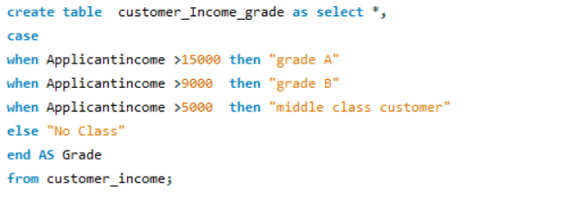
Customer Income
Import table from customer income data
Setting Income Grading Criteria based on applicant income
Applicant income >15,000 = grade a
Applicant income >9,000 = grade b
Applicant income >5000 = middle class customer
Otherwise low class and creating as a new Table

Slide 9
Trigger
A trigger in SQL is a special type of stored procedure that automatically executes or "fires" when a specific event occurs in a database table, such as when a record is inserted, updated, or deleted. It is used to enforce business rules, maintain data integrity, or log changes to a table without needing manual intervention.

Slide 10
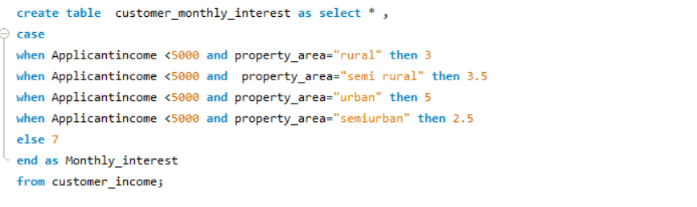
Customer Income
Setting Monthly Interest Calculation
Applicant income <5000 rural=3%
Applicant income <5000 semi rural=3.5%
Applicant income <5000 urban=5%
Applicant income <5000 semi urban= 2.5%
Otherwise =7% and creating as a new table

Slide 11
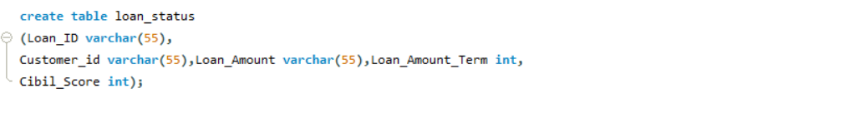
Loan Status
Create row level trigger for loan amount.
Before that we need manually create the table and then we need apply the First trigger

Slide 12
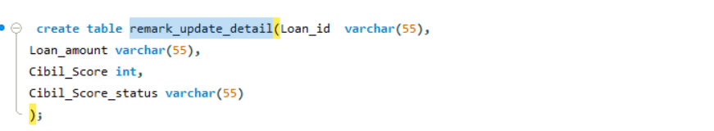
Loan Status
Before creating the second trigger, we need to first create a table called remark_update_detail for updating loan CIBIL scores.
Once this table is created, the second trigger will be set up, and it will automatically fire when new data is inserted into the Loan status table.
Due to this data injection, the first trigger will execute as per the rules defined in the trigger logic

Slide 13
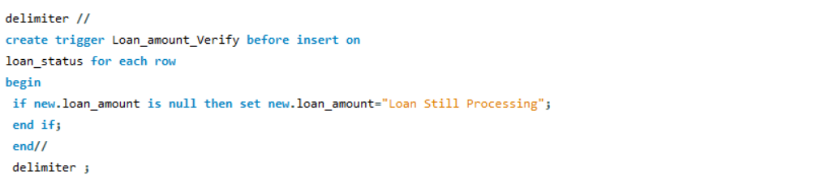
Loan Status
First Trigger Under the Criteria if the Loan amount is null it show “loan still processing”

Slide 14
Loan Status
The second trigger will be applied based on the following criteria will get updated in another table:
If the CIBIL score is greater than 900, it is categorized as a high CIBIL score.
If the CIBIL score is greater than 750, there will be no penalty.
If the CIBIL score is greater than 0, the customer will be categorized under penalty.
If the CIBIL score is lesser than 0, the customer will be categorized under reject customers
Remove customers who are either rejected or whose loan is
still being processed.
Update the loan amounts to be stored as integers.

Slide 15
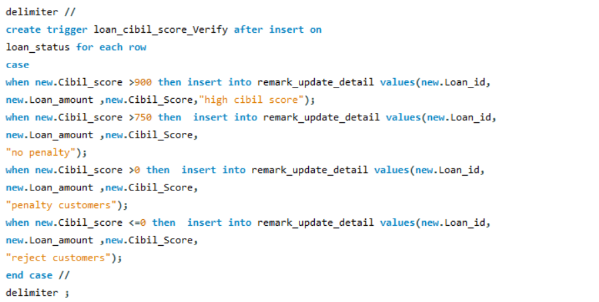
Loan Status
Second trigger Script:

Slide 16
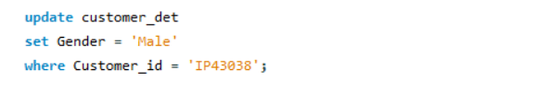
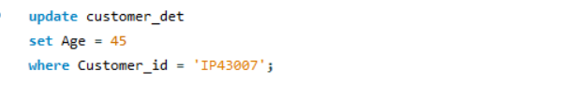
Customer Info
Load the table into the system.
Modify the gender and age fields by matching them with the corresponding customer ID.
For example:

Slide 17
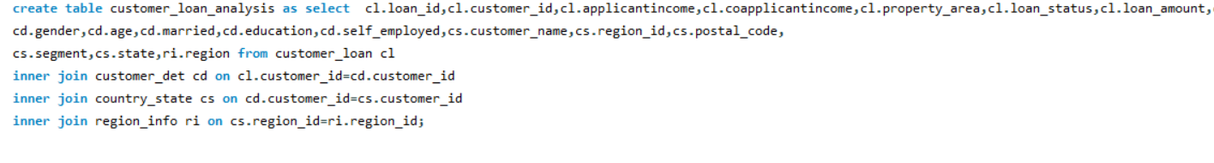
Country State And Region
Load the table into the system.
Combine all five tables by joining them without duplicating any
fields.

Slide 18
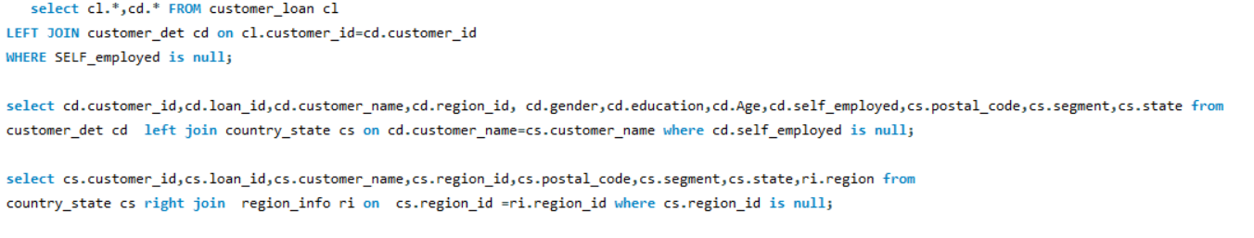
Country State And Region
Identify and highlight discrepancies or mismatched data by using joins

Slide 19
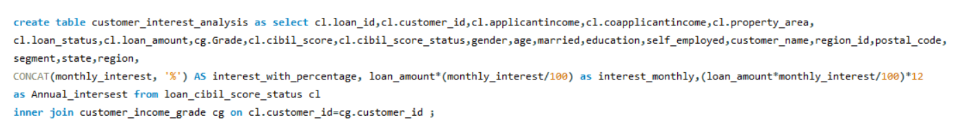
Customer Interest Analysis
Calculate monthly interest amt and annual interest amt based on loan amt
Create all the above fields as a table
Table name - customer loan analysis

Slide 20
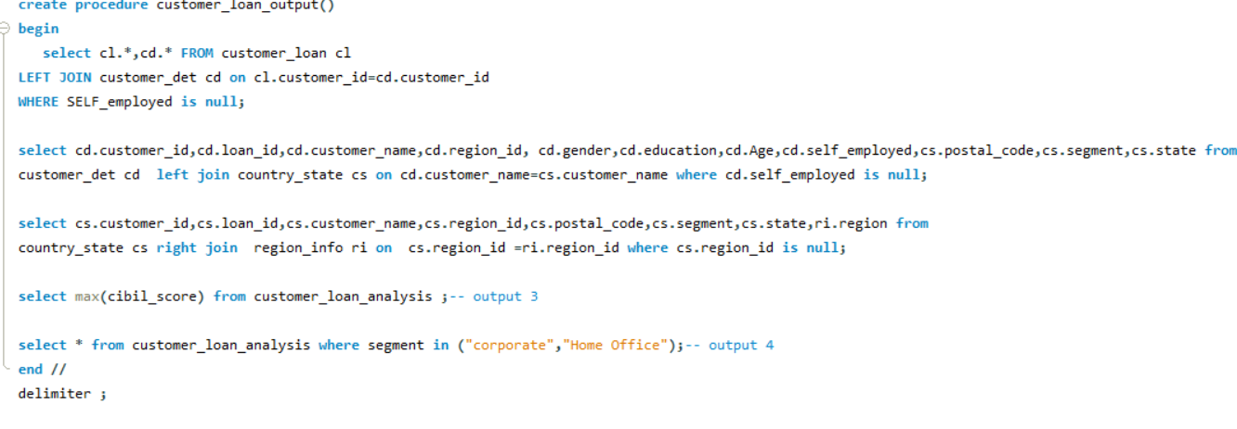
Stored Procedure
Filter out customers with a high CIBIL score (Output 3).
Filter customers belonging to the "Home Office" and "Corporate" segments (Output 4).
Store both Mismatching, Output 3 and Output 4 as part of a stored procedure for future use or reporting
Finally export the output as a csv file , script to share with colleague for collaboration and also for future analysis.

Slide 21
Conclusion
Loan management system analysis helps in:
Risk-Based Pricing Implementation Leverage CIBIL score analysis to develop a more nuanced pricing strategy
Tailor interest rates to individual risk profiles, optimizing risk-reward balance
Continual refinement of credit scoring models
Development of area-specific loan products
Implementation of income-based loan limits and terms

Slide 22
Thank you !

